Slide 1
Preliminary Figures and Tables
Generated using R
(R script attached)

Slide 2
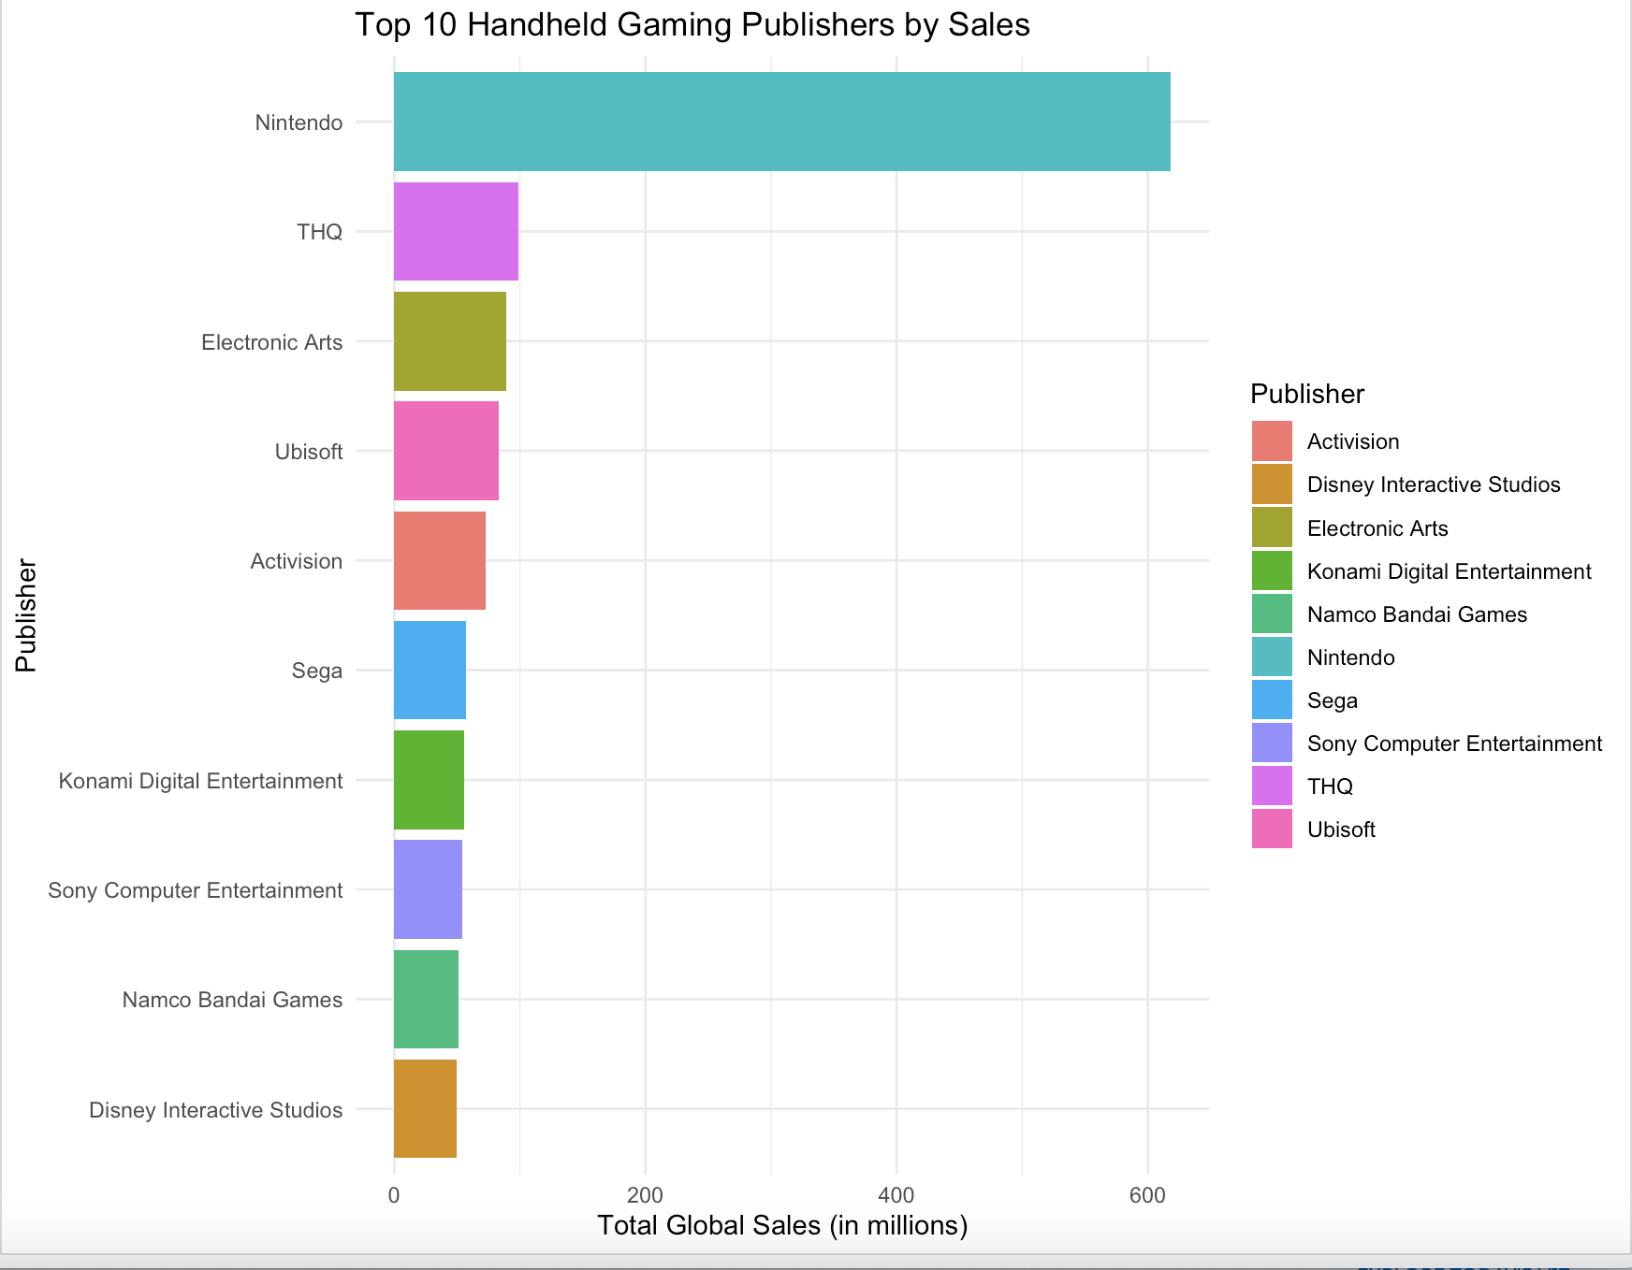
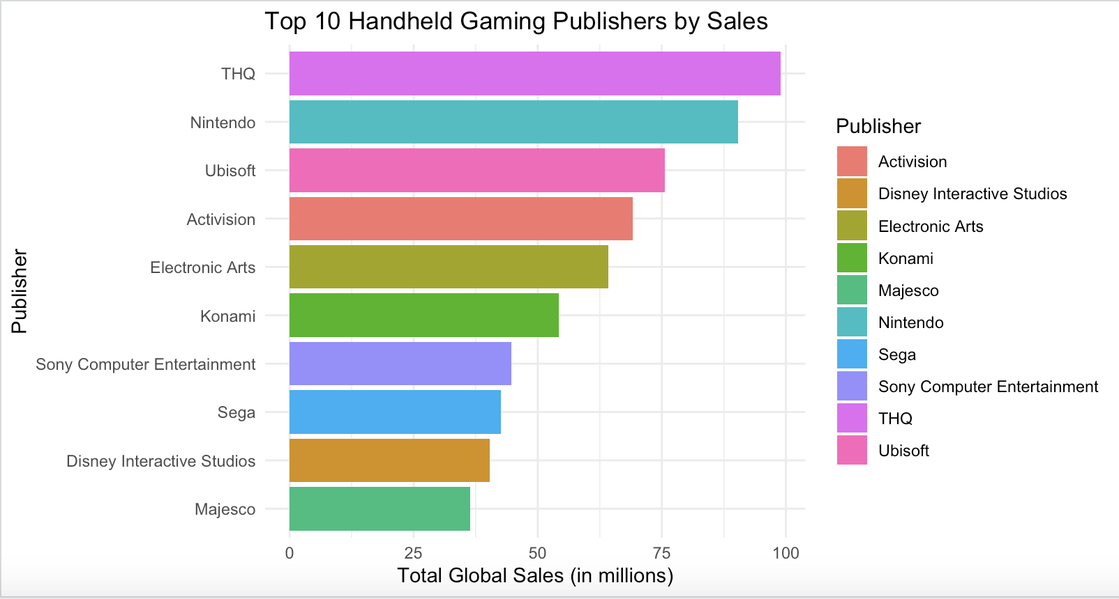
Top 10 Handheld Gaming Publishers by sales

Slide 3
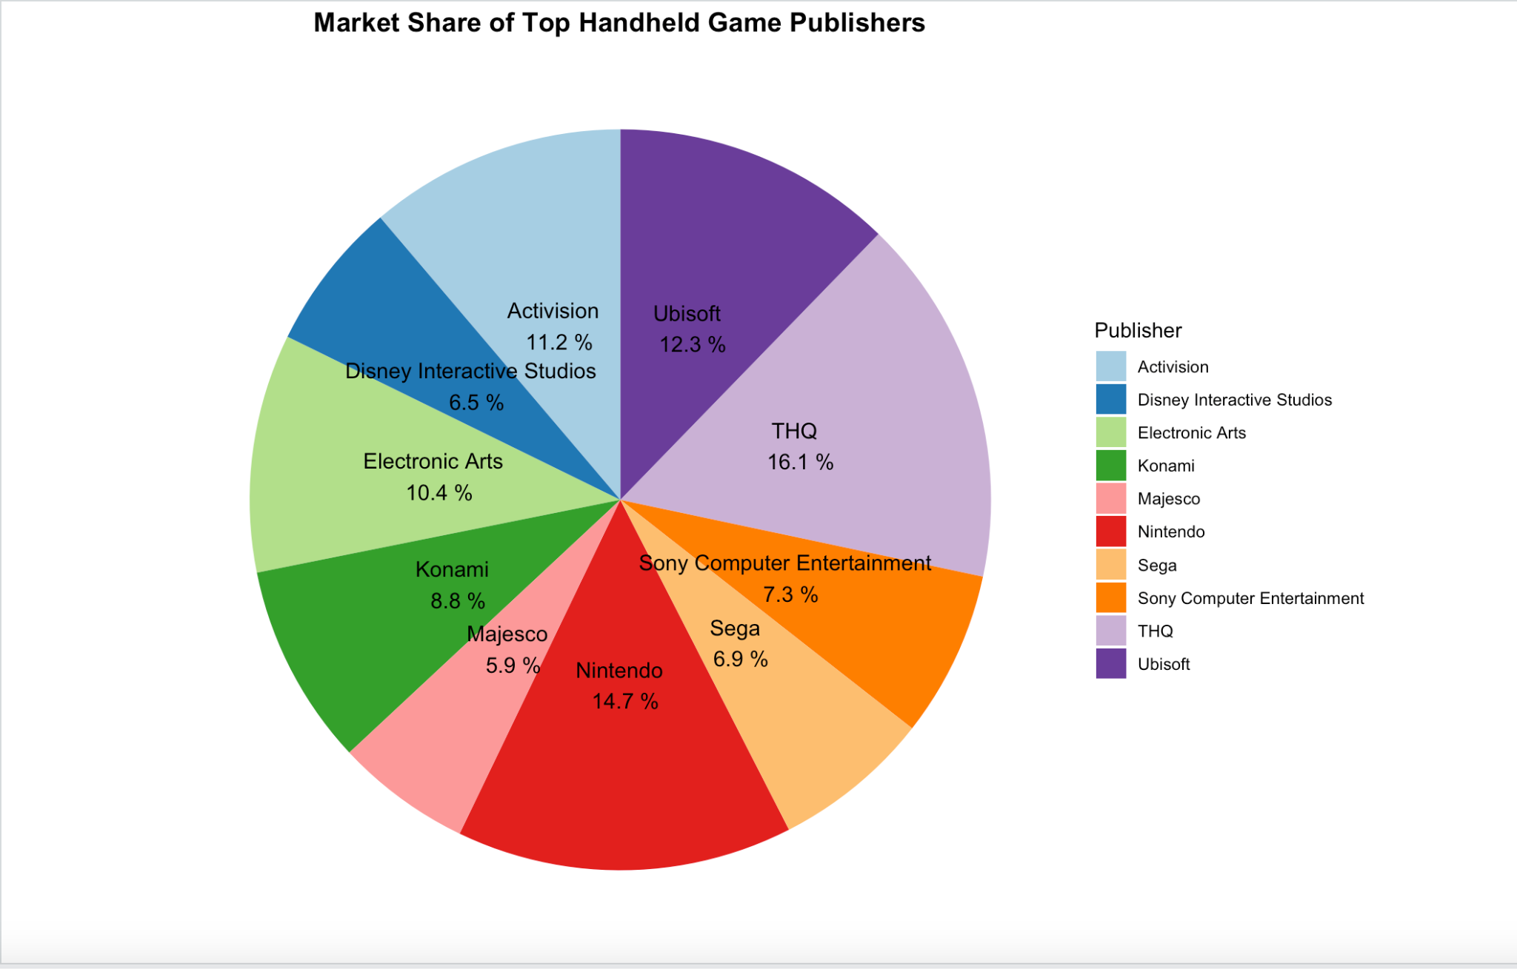
Market Share of Top Handheld Game Publishers

Slide 4
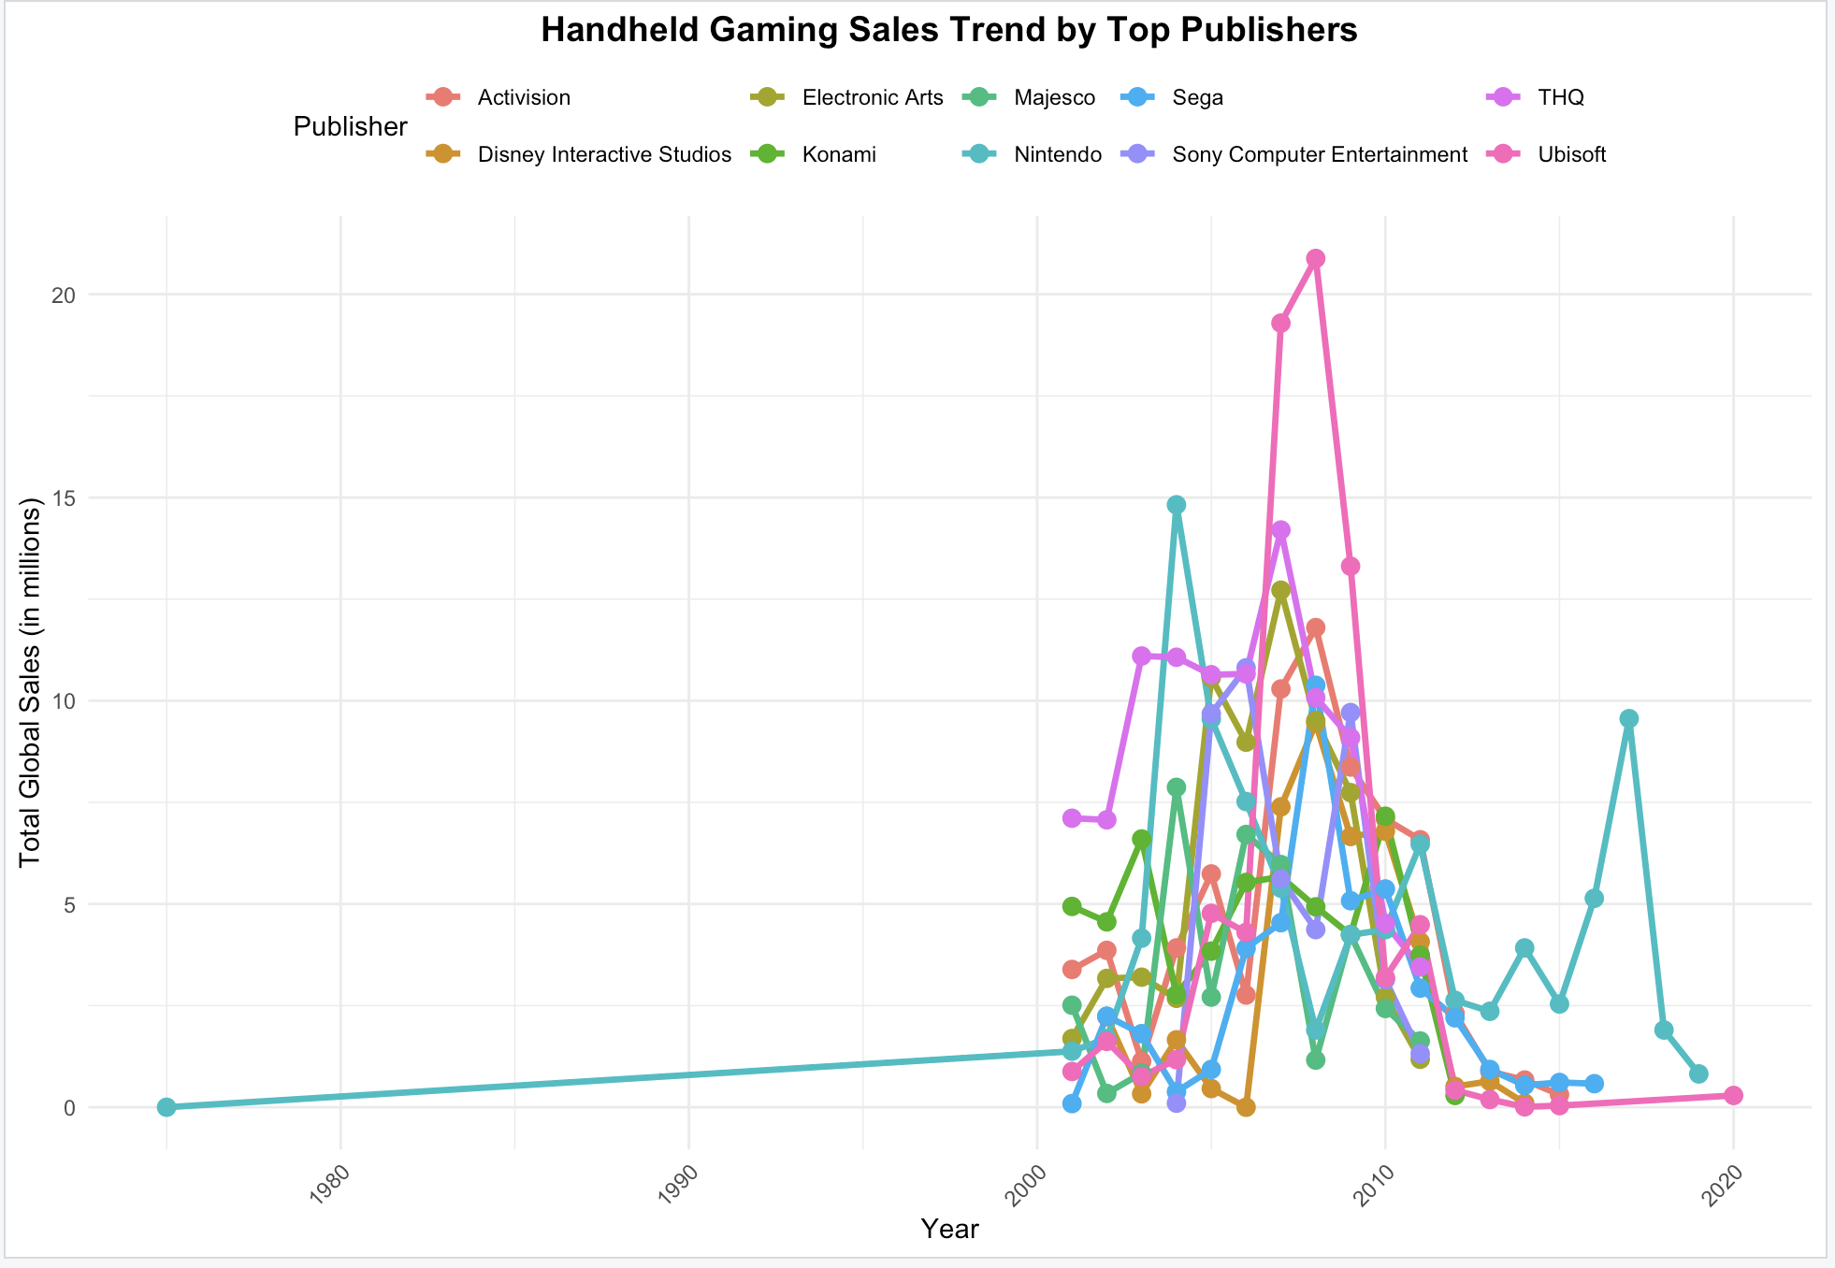
Trend Analysis

Slide 5
TABLE 1 : Top Handheld Publishers
Publisher | Total_Sales (millions)
THQ | 98.99
Nintendo | 90.36
Ubisoft | 75.61
Activision | 69.1
Electronic Arts | 64.15
Konami | 54.27
Sony Computer Entertainment | 44.75
Sega | 42.52
Disney Interactive Studios | 40.29
Majesco | 36.42

Slide 6
TABLE 2: Top Hand Held games
Name | Platform | Publisher | Global_Sales (millions)
Grand Theft Auto: Liberty City Stories | PSP | Rockstar Games | 7.72
Cooking Mama | DS | Majesco | 5.66
Mario & Sonic at the Olympic Games | DS | Sega | 5.1
Grand Theft Auto: Vice City Stories | PSP | Rockstar Games | 5.08
LEGO Star Wars: The Complete Saga | DS | LucasArts | 4.77
Namco Museum | GBA | Namco | 4.24
Daxter | PSP | Sony Computer Entertainment | 4.23
Ratchet & Clank: Size Matters | PSP | Sony Computer Entertainment | 3.75
Midnight Club 3: DUB Edition | PSP | Rockstar Games | 3.66
MySims | DS | Electronic Arts | 3.66

Slide 7
Insights from Interactive dashboard build using Tableau for preliminary analysis
Regional Sales Distribution (Top Chart)
Global Sales Trends:
Sports (1,228M), Action (1,207M), and Shooter (1,052M) are the top-selling genres globally.
Puzzle (133M) and Visual Novel (3M) have significantly lower sales.
Regional Preferences:
North America (NA) dominates sales across almost all genres, especially Sports (628M) and Shooter (566M).
Japan (JP) has relatively lower sales, with the highest being Role-Playing (162.8M) and Fighting (63.4M).
PAL regions (Europe, Australia) show strong sales in Sports (354.1M) and Action (367M).
Other regions contribute the least to total sales.
Sales by Genre (Bottom Left)
Sports, Action, and Shooter genres continue to dominate.
Role-Playing and Racing are mid-tier performers.
Adventure and Fighting games are less dominant globally.
Handheld Platform Sales Trend (Bottom Right)
The DS had the largest peak around 2005-2010.
Other handheld platforms followed a similar pattern but at a lower scale.
Handheld gaming sales significantly dropped after 2015, likely due to mobile gaming and next-gen consoles.

Slide 8
